Slide 1

CRICKET PLAYERS PERFORMANCE SYSTEM
HEMA MADHURI JANAPAMULA
189665

Slide 2
ABSTRACT
This project is aimed at developing Cricket Players Performance System (CPPS).
This system is used to check the performance of the players in cricket from different countries in various international matches.

Slide 3
Technologies
Oracle 11G/SQL Server (Database)
Informatica power center
Tableau Desktop

Slide 4
Project Flow

Slide 5
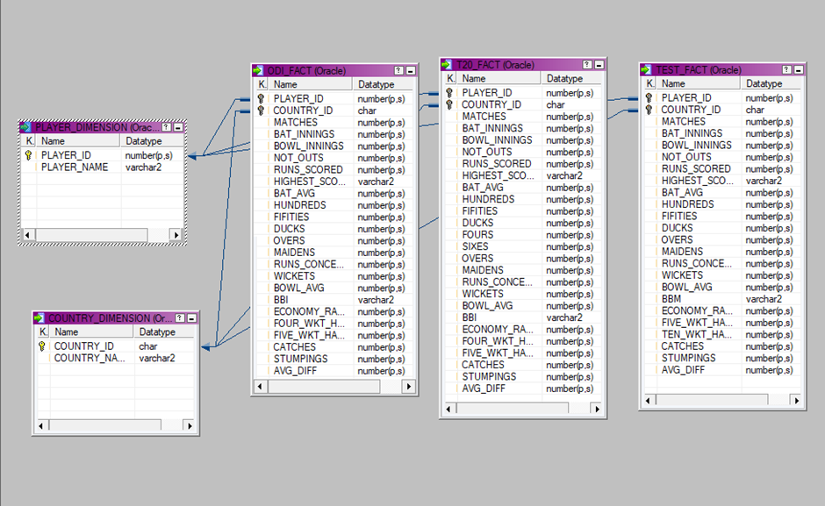
Schema design

Slide 6
SOURCE DATA
The source data contains player names, matches, bat-innings, overs and so on.
The source data is as follows
1.ODI (batting, bowling, fielding)
2.Test (batting, bowling, fielding)
3.T-20 (batting, bowling, fielding)

Slide 7
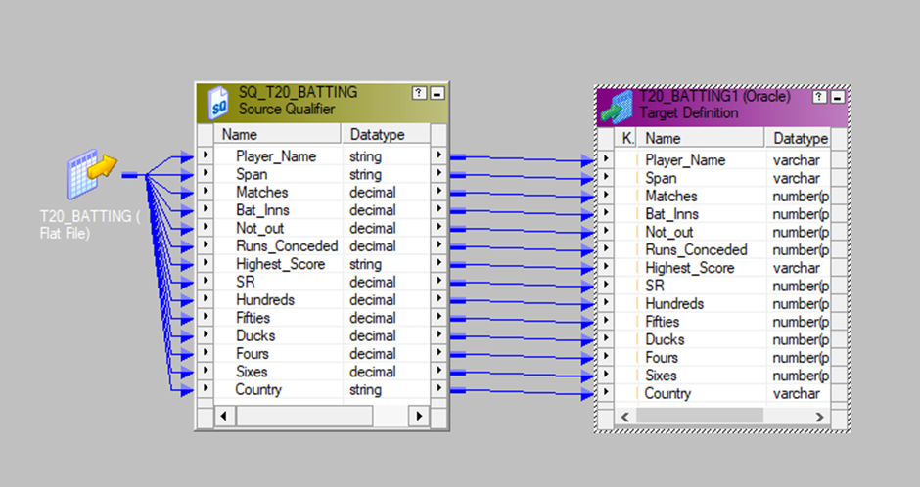
STAGING

Slide 8
Dimension Tables and Fact tables
Two dimension tables
1.Player dimension
2.Country dimension
Three Fact tables
1.ODI_fact
2.Test_fact
3.T20_fact

Slide 9
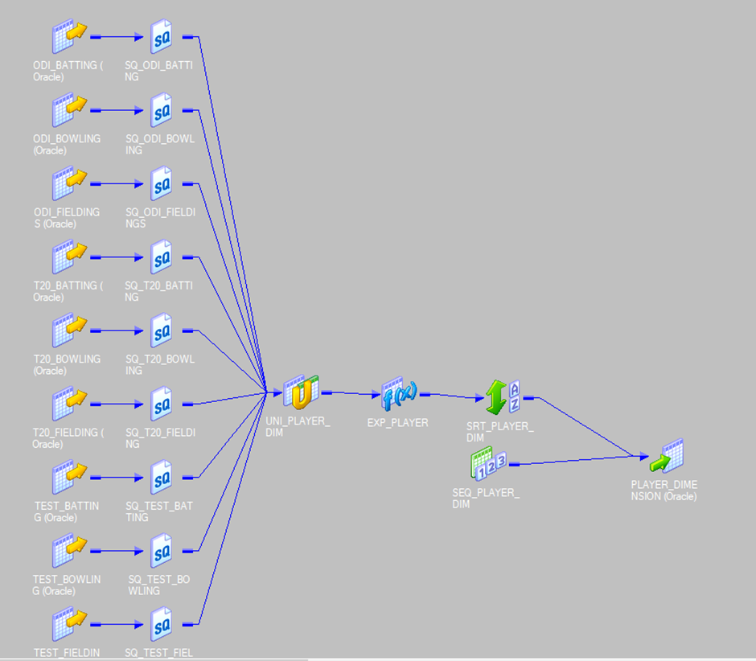
Mapping of Dimension Table
Player Dimension

Slide 10
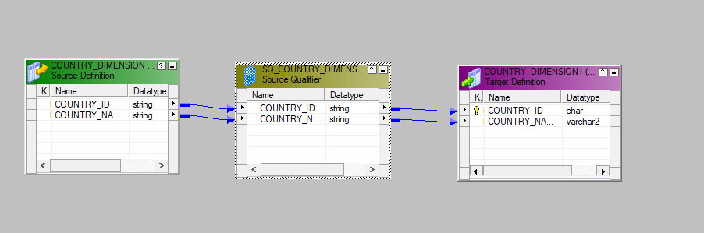
Country dimension

Slide 11
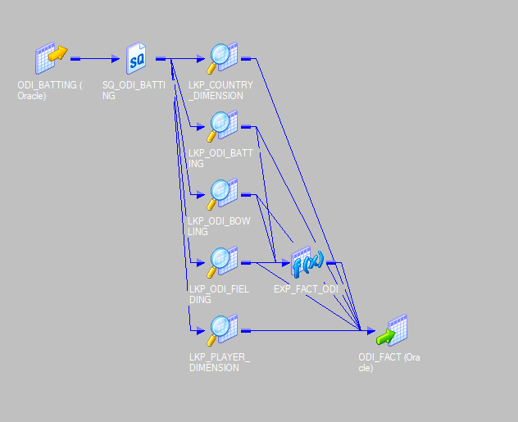
Mapping of Fact Tables ODI fact table:

Slide 12
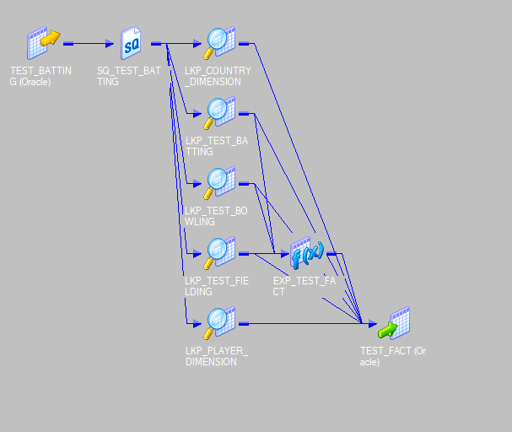
Test Fact Table

Slide 13
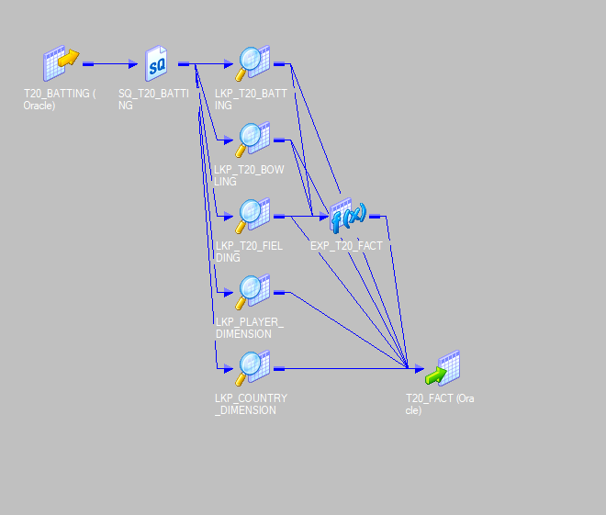
T20 Fact Table

Slide 14
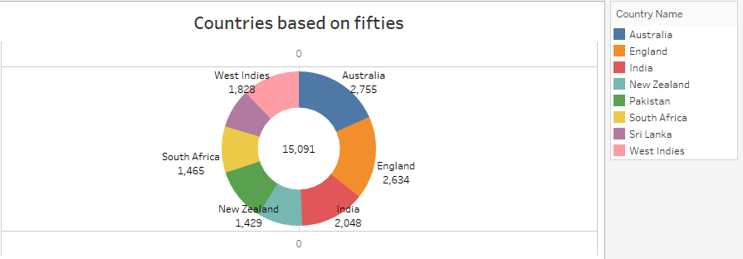
REPORTS

Slide 15
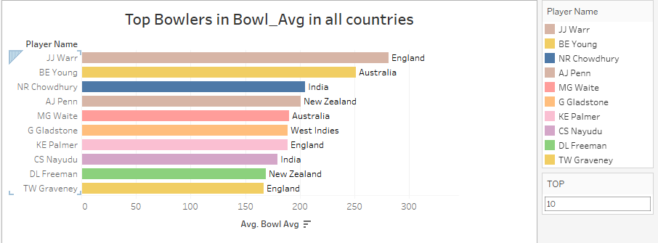

Slide 16
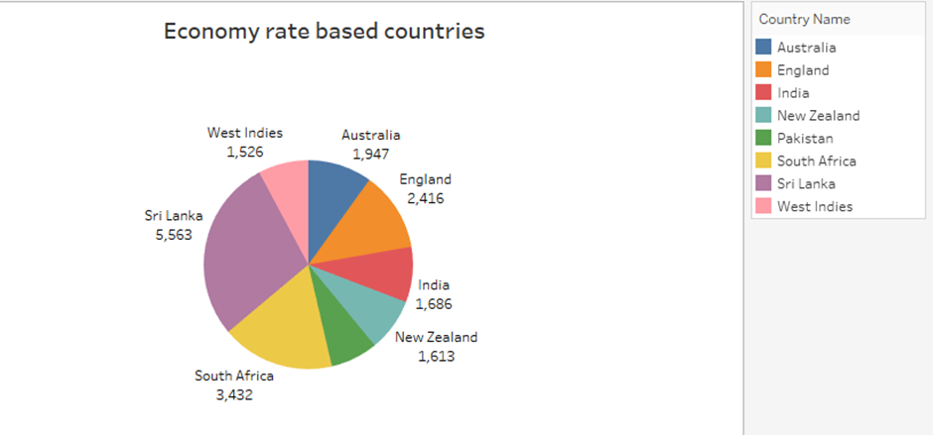

Slide 17
THANK YOU

